Slide 1
Universal Acceptance (UA) of Domain Names and Email Addresses
[Presenter Name] / UA Day Awareness Session / [Day, month] 2024

Slide 2
Digital Inclusion, A Long Standing Commitment
United Nations sponsored the World Summit on Information Society (WSIS) for Building the Information Society, A Global Challenge in the New Millennium.
The following Principles were affirmed by the global community during WSIS at the Geneva Summit 2003:
We, the representatives of the peoples of the world, assembled for the first phase of the World Summit on the Information Society (WSIS), declare our common desire and commitment to:
Build a people-centered, inclusive and development-oriented Information Society,
Where everyone can create, access, utilize and share information and knowledge,
Enabling individuals, communities and peoples to achieve their full potential in promoting their sustainable development and improving their quality of life.

Slide 3
We Live in a Multilingual World!
Globally, language usage is diverse. English comes third in terms of native speakers around the world, after Mandarin and Spanish. English represents 57% of the total written content online and the percentage is decreasing.
Language | Native Speakers
Mandarin | 1300 million
Spanish | 475 million
English | 373 million
Arabic | 362 million
Hindi | 344 million
Bengali | 234 million
Portuguese | 232 million
Russian | 154 million
Japanese | 125 million
Source: https://w3techs.com/technologies/history_overview/content_language.
Source: https://www.babbel.com/en/magazine/the-10-most-spoken-languages-in-the-world

Slide 4
Multilingualism, A Key To Digital Inclusion
A linguistically diverse Internet significantly contributes toward a knowledge-based society by bridging the digital divide
Therefore, linguistic diversity online was a key principle in WSIS Geneva Declaration in 2003, leading to a commitment “towards multilingualization of the Internet” in the WSIS Tunis Agenda in 2005. This included a specific ask for the following:
Advance the introduction of multilingualism in domain names and email addresses by implementing programs and strengthening cooperation for their global deployment

Slide 5
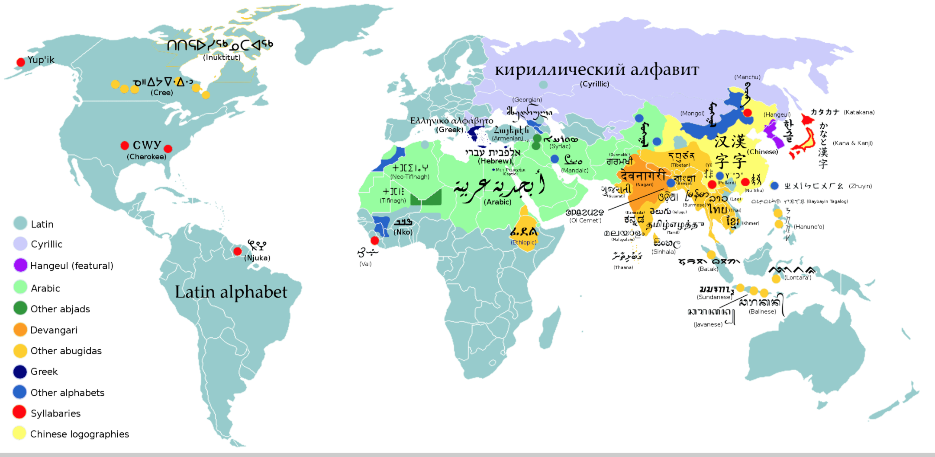
Multilingualism, A Key To Digital Inclusion
UNESCO, in its multilingualism and universal access to cyberspace 2003 recommendations, asked to alleviate language barriers on the Internet by access to content, capacity-building, national policies, and collaborative research and development on and local adaptation of technology with extensive multilingual capabilities
Source: https://en.wikipedia.org/wiki/List_of_writing_systems.

Slide 6
The Domain Name System (DNS) and ICANN
A domain name is a unique name that forms the basis of the uniform resource locators (URLs) that people use to find resources on the Internet (e.g., web pages, email servers, images, and videos)
The domain name itself identifies a specific address on the Internet that belongs to an entity such as a company, organization, institution, or individual
For example, the domain name: wikipedia.org is used to point to the address: 208.80.154.224
Collectively, the domain names and the Internet Protocol (IP) addresses help us navigate the Internet
The Internet Corporation for Assigned Names and Numbers (ICANN) helps coordinate and support these unique identifiers across the world. ICANN's mission is to help ensure a stable, secure, and unified global Internet.

Slide 7
Evolution of Top-Level Domains (TLDs) and the DNS
In the past, top-level domains (TLDs) have mostly been two or three letters long formed with Latin characters a-z (e.g., .com, .org)
The evolution of the DNS has allowed for newer and longer TLDs. There are now around 1,200 new generic gTLDs that represent brands, communities, and geographies (e.g., .photography, .london)
These new TLDs also include Internationalized Domain Names (IDNs), which allow for domain names in local languages and scripts such as “.例子” and “مثال.“ (“example” written in Chinese and Arabic)
Other labels within a domain name can also be internationalized, allowing for a domain name to be in a local language and script completely. IDNs are separate from online content, which can also be multilingual
The next round of gTLDs will continue to expand the DNS and give new opportunities to the next billion people waiting for access to a more multilingual and inclusive Internet in their language or script

Slide 8
Expansion of the DNS and the Next Round
The introduction of new gTLDs, including long TLDs and IDNs, into the Internet ecosystem through the New gTLD Program enabled the largest expansion of the DNS.
Pre-2009
2016
2012-onward
2009-onward
Generic TLDs (gTLDs)
(22 total)
IDN ccTLDs
(in non-Latin scripts)
New gTLD Program
New and Long gTLDs
(Over 1,200 total)
.com
.edu
.рф
.台灣
.org
.net
.한국
.ଭାରତ
.bank
.bar
.technology
.aero
.asia
.car
.global
.london
.mobi
.travel
.rio
.vote
.photography
.info
IDN gTLDs
(in various scripts)
Country Code TLDs (ccTLDs)
(two-character ASCII ccTLDs)
.संगठन
.在线
.uk
.jp
.닷넷
.ストア
.de
.fr
.ابوظبي
. дети

Slide 9
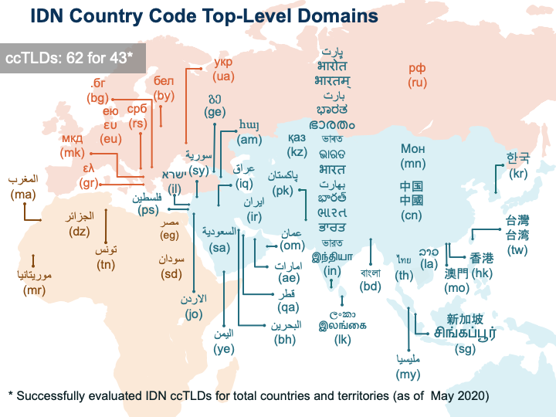
IDN Country Code Top-Level Domains (ccTLDs)

Slide 10
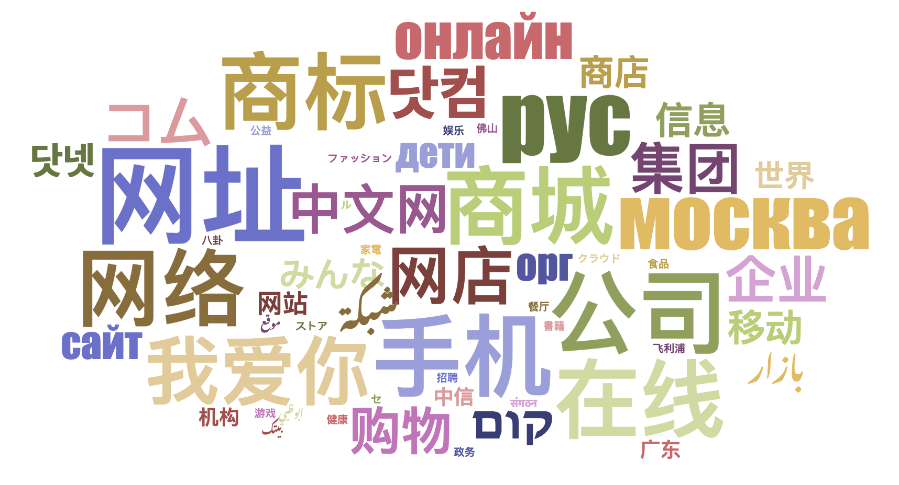
IDN Generic TLDs (gTLDs)
90 IDN gTLDs are delegated.

Slide 11
Evolution of Email Addresses
Initially, email addresses were also not available in local languages and scripts
Email Address Internationalization (EAI) addresses this limitation and allows for having email addresses in local languages and scripts
Internationalized email addresses are not related to the text in the body of the email, which is managed through the Multipurpose Internet Mail Extensions (MIME)

Slide 12
Examples of IDNs
համընդհանուր-ընկալում-թեստ.հայ
ଯୁନିଭରସାଲ-ଏକସେପ୍ଟନ୍ସ-ଟେଷ୍ଟ.ଭାରତ
უნივერსალური-თავსობადობის-ტესტი.გე
다국어도메인이용환경테스트.한국
സാർവത്രിക-സ്വീകാര്യതാ-പരിശോധന.ഭാരതം
تجربة-القبول-الشامل.موريتانيا
Armenian
Oriya
Georgian
Korean
Malayalam
Arabic

Slide 13
Examples of Internationalized Email
Էլփոստ-թեստ@համընդհանուր-ընկալում-թեստ.հայ
电子邮件测试@普遍适用测试.我爱你
ईमेल-परीक्षण@सार्वभौमिक-स्वीकृति-परीक्षण.संगठन
تجربة-بريد-الكتروني@تجربة-القبول-الشامل.موريتانيا
ηλεκτρονικό-μήνυμα-δοκιμή@καθολική-αποδοχή-δοκιμή.ευ
மின்னஞ்சல்-சோதனை@பொது-ஏற்பு-சோதனை.சிங்கப்பூர்
Armenian
Chinese
Devanagari
Arabic
Greek
Tamil

Slide 14
The Challenge
IDN TLDs allow for multilingual domain names and email addresses for communities to register and use, allowing for more digital inclusion.
But, there are issues in their acceptance, e.g., a valid email is rejected by a form on a website and is incorrectly displayed from left-to-right instead of right-to-left:

Slide 15
The Challenge: Acceptance by Websites
Source: UASG039 at https://uasg.tech, published in 2022

Slide 16
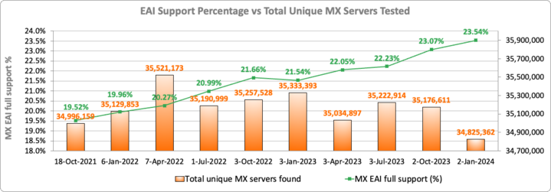
The Challenge: Support Across Email Servers
Source: https://ithi.research.icann.org/graph-eai.html

Slide 17
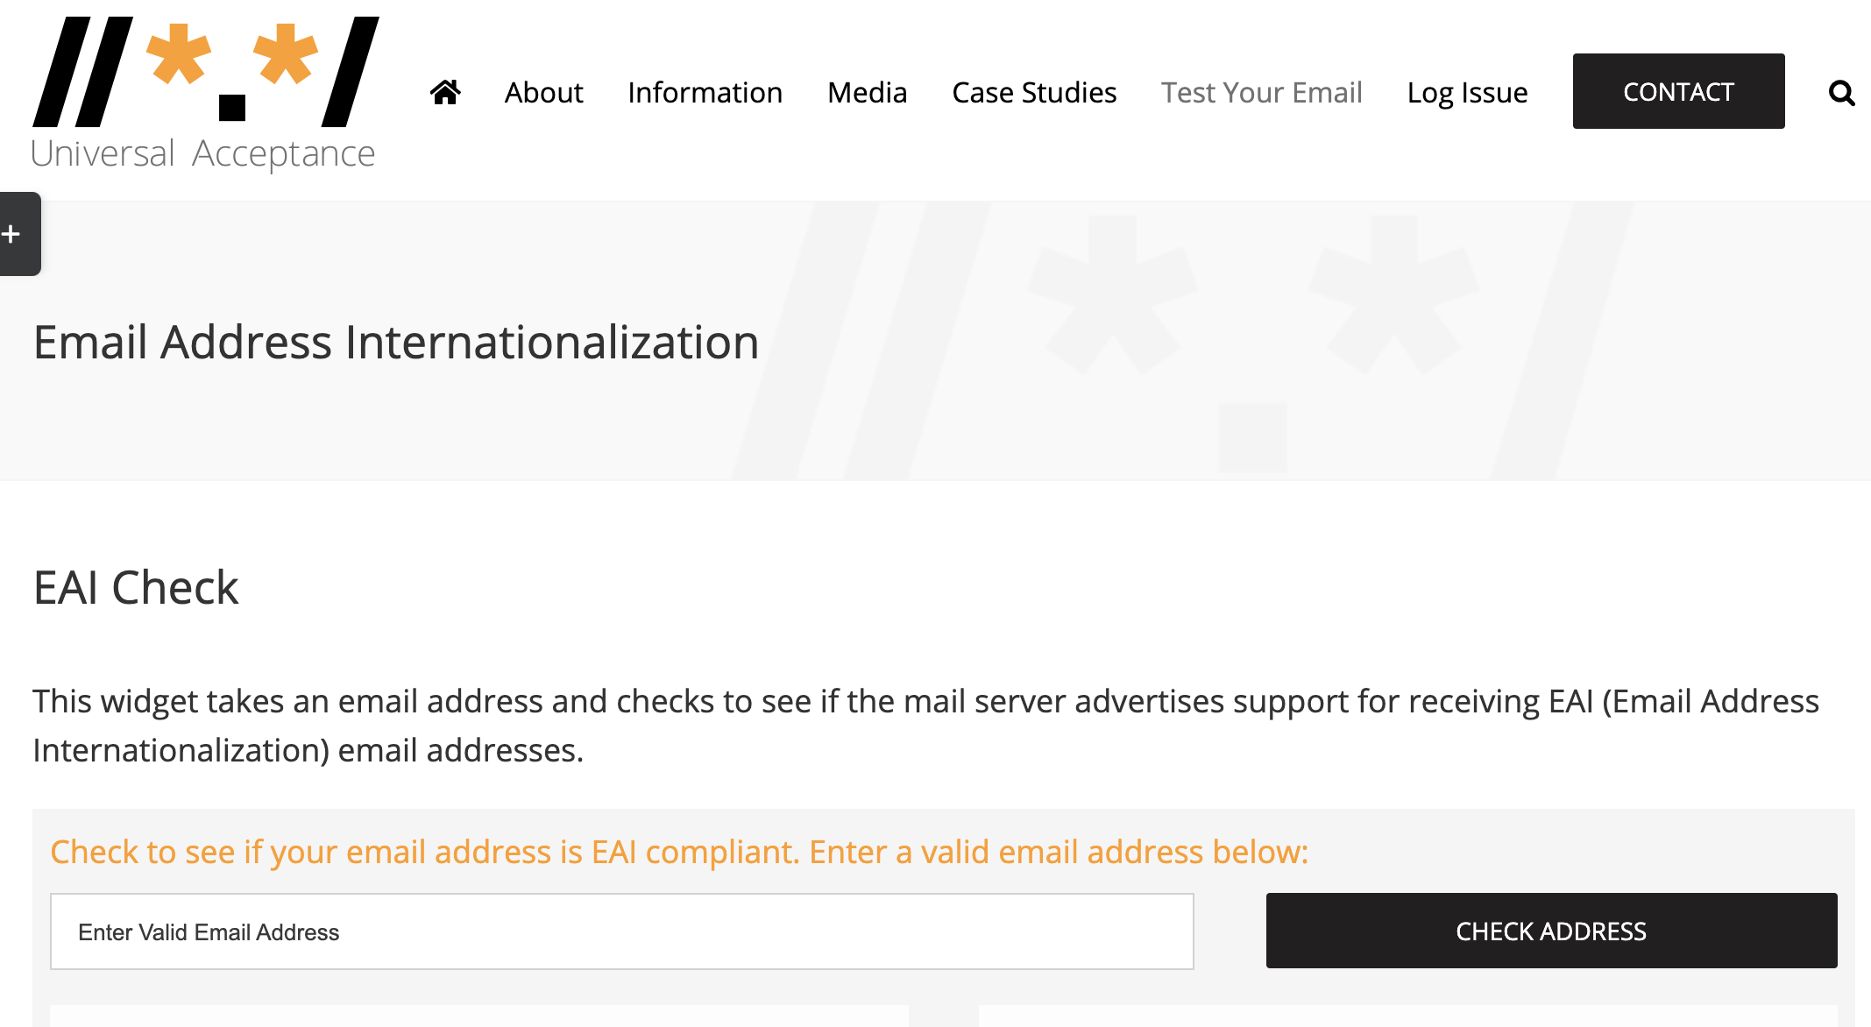
Does Your Email Server Support EAI?
Enter your email and check now at: https://uasg.tech/eai-check/

Slide 18
Digital Inclusion, an Opportunity
Remaining one-third of the world population, ~2.6 billion people, still aren’t online; primarily from Asia and Africa.
Many of those already online, and most of those who will be coming online, communicate in their native languages.
Source: https://www.itu.int/itu-d/reports/statistics/2023/10/10/ff23-internet-use/

Slide 19
Multilingualism Online, A Continued Challenge
Due to the need for multilingual Internet and the continued gaps in the technology (among other factors), WSIS+10 Outcome Documents noted the continued need for supporting multilingualism on the Internet
As part of the priority areas to be addressed in the implementation of WSIS Beyond 2015, the report specifically asks for:
Working towards multilingualization of Information and Communication Technologies (ICTs,) including email and native capability for international domain names (IDN), so that all members of the community are able to participate in online life
Supporting and encouraging stakeholders, in their respective roles and responsibilities, to work together for technical evolution of the ICTs with a vision of a linguistically diverse digital world

Slide 20
What is Universal Acceptance (UA)?
While the DNS has evolved, the checks used by many software applications to validate domain names and email addresses remain outdated
In addition, not all online portals are primed for the opening of a user account with a related email address, leaving many people unable to navigate the Internet using their language and online identity of choice
Considered a technical compliance best practice, UA solves these issues by ensuring all valid domain names and email addresses, regardless of script, language or character length, can be used equally by all Internet-enabled applications, devices, and systems

Slide 21
UA Goal and Impact
Goal
All valid domain names and email addresses work in all software applications.
Impact
Promote consumer choice, improve competition, and provide broader access to end users.

Slide 22
Examples of Categories Affected by UA
Domain Names that may not work in applications:
ASCII: example.sky
ASCII: example.engineering
Unicode: คน.ไทย
Internationalized email addresses (EAI) that may not work in applications:
Unicode: marc@société.org
Unicode: 测试@example.com
Unicode: ईमेल@उदाहरण.भारत
Unicode: ای-میل@ مثال.موقع (written right-to-left, RTL)
ASCII is based on letters A-Z, a-z, digits 0-9 and hyphen.
Unicode supports characters of global languages and scripts.

Slide 23
Why Does UA Matter?
Achieving UA ensures every person has the ability to navigate and communicate on the Internet using their chosen domain name and email address that best aligns with their interests, business, culture, language, and script.
UA can also help:
Support a diverse and multilingual Internet
Enable greater competition, innovation, and consumer choice
Create business opportunities
Offer career advantages for developers and system administrators
Assist governments and policymakers in reaching their citizens

Slide 24
Making Applications UA-Ready
Support all valid domain names and email addresses:
Accept: The user can input characters from their local script into a text field
Validate: The software accepts the characters and recognizes them as valid
Process: The system performs operations with the characters
Store: The database can store the text without breaking or corrupting
Display: When fetched from the database, the information is correctly shown
Accept
Validate
Process
Store
Display

Slide 25
A Call to Action
International Telecommunication Union (ITU) Plenipotentiary Resolution 133 (Revision Bucharest 2022) focuses on the Role of administrations of Member States in the management of internationalized (multilingual) domain names:
Emphasizes
IDNs contribute to sustainable development through the promotion of greater Internet accessibility and use in local languages
The need to continue to implement technical solutions to enhance the implementation of IDNs
Recognizes
The role played by governments, technical communities and other stakeholders in advancing multilingualism, including the introduction of internationalized domain names
The importance of community engagement and information-sharing to get a better understanding of existing challenges and to support solutions, particularly in developing countries

Slide 26
A Call to Action
International Telecommunication Union (ITU) Plenipotentiary Resolution 133 (Revision Bucharest 2022) focuses on the Role of administrations of Member States in the management of internationalized (multilingual) domain names:
Invites Member States and Sector Members
To consider how to further promote the adoption of Universal Acceptance in respect of IDNs and to collaborate and coordinate with relevant organizations and stakeholders in enabling the use of IDNs in the Internet

Slide 27
Working Towards UA-Readiness
The ICANN community organized to promote UA-readiness globally, including the Universal Acceptance Steering Group (UASG)
ICANN and its community work to achieve UA-readiness by:
Organizing outreach to raise awareness on UA issues
Conducting detailed studies to identify technical gaps
Determining solutions to address the technical gaps
Submitting bug reports in the relevant tools, systems, and applications
Conducting technical training on the solutions for supporting UA-readiness
Developing curricular recommendations for IT programs
More info at https://icann.org/ua

Slide 28
Who Can Help Achieve UA?
Technology Enablers - Organizations producing relevant standards and best current practices and providers of software programming languages, tools, and frameworks
Technology Developers - Organizations and individuals developing and deploying online applications and services using the programming languages, tools, and frameworks
Email Software and Service Providers
Email Software Providers - Organizations and individuals providing different applications, tools, and utilities for the email ecosystem
Email Service Providers - Organizations and individuals providing services for the email ecosystem
Email (and System) Administrators - Organizations and individuals deploying and administering email-related software and services
Government Policymakers - Government officials generating demand for UA-ready products and services by updating accessibility standards and procurement processes
Academia – University programs offering IT-related degree programs

Slide 29
What Is Your Role: Business
Many businesses are leaving money on the table by not updating their systems to be UA-ready, which has the potential to unlock billions in revenue from untapped customers.
A UASG study, conducted in 2017, found that the Universal Acceptance of Internet domain names is a $9.8+ billion opportunity, which is a conservative estimate.
Businesses that are UA-ready will be best positioned to reach growing global audiences and maximize revenue potential from the current Internet population, as well as the next billion.
Organize internally and assess if your business’ systems are compliant with UA standards
Update your own IT systems to be UA-ready
Encourage your collaborators to participate and promote local UA-related discussions
Create UA awareness with partner organizations and companies, aiming to update their systems to current globally-inclusive standards

Slide 30
What Is Your Role: Government
Based on ITU Resolution 133 on IDN management and UNESCO recommendations on multilingualism and cyberspace
Collaborate for development and deployment of IDNs
Promote capacity-building, information-sharing and the exchange of best practices among all stakeholders for IDN implementation
Consider how to further promote the adoption of Universal Acceptance in respect to IDNs
Being UA-ready can assist governments and policymakers in reaching their citizens
Evaluate the possibility of including UA requirements in government procurements
Reach out to government departments involved in e-government services for citizens and ask them to incorporate UA practices to provide digital inclusivity
Coordinate with your national ccTLD managers and ICANN Governmental Advisory Committee (GAC) delegates to participate in and strengthen UA-related actions

Slide 31
What Is Your Role: Civil Society
Encourage your community to attend local and regional UA-related events; help coordinate and promote them
Make your own systems UA-ready for broader digital inclusion
Promote research on inclusion and access that reinforces the principles of UA
Create UA awareness with partner organizations and companies to update their systems to current globally-inclusive standards

Slide 32
What Is Your Role: Academia
Upgrade email systems to support EAI
Update IT curricula to include teaching and learning of UA and software internationalization related concepts
See draft guidelines and detailed materials for integrating IDN and UA concepts in IT curriculum
Train faculty and students to adopt UA practices in software development
Create awareness of UA issues and solutions in the local technical community

Slide 33
What Is Your Role: Technical Community
Carry out training and educational activities that allow software developers and project managers to address UA-related issues
Test and address UA-related issues in your own products and services
Report bugs related to UA in other products and services

Slide 34
What Is Your Role: DNS Industry
Assess UA-related gaps in customer facing systems
Upgrade customer-facing systems to support UA
For registries and registrars, UA Roadmap for Domain Name Registry and Registrar Systems is available as a guide
Training materials available for hosting providers and Internet service providers
Create awareness of UA with your business stakeholders and encourage them to upgrade their systems as well
Make sure a registrant has services available for all the steps needed from registering a domain name, to hosting websites as well as creating and managing mailboxes using the domain name
If a registrant can register a domain name, but cannot host it, then it will hinder adoption

Slide 35
What is Your Role: Domain Holder/Registrant
Check with your Internet Service Provider (ISP) hosting your website and email to see if their services are UA-ready
Check with your website and email admin if your website and email is UA ready. If it is not, consider taking the initiative to update it and make it UA-ready
Create UA awareness with your ISP, web developers and email admin, and ask them to update their systems to be UA-ready. Refer them to FY23 UA Readiness report for further information. You may consider using the template letter or alternatively log the issue

Slide 36
Ongoing Work at ICANN
UA
ccTLDs
gTLDs
LGR
Updating own software and systems to support all valid domain names
IDN ccTLD Fast Track available
Delegated first IDN gTLDs through the application round in 2012
Developing secure Label Generation Rules (LGR) for multiple scripts
Supporting community to raise awareness and capacity
Expanded policy and process under development
Next gTLD application round under development
Developing tools to use these LGRs
For further information visit https://icann.org/idn and https://icann.org/ua.

Slide 37
New gTLD Program: Next Round
New opportunities to obtain a new generic top-level domain (gTLD), including Internationalized Domain Names (IDNs), are on the horizon
The application window for the next round is expected to open in Q2 2026
The next expansion of the Domain Name System (DNS) will enable people and organizations to manage their presence and identity on the Internet
Domain names in various languages and scripts will help build online digital inclusivity
An Applicant Support Program (ASP) will benefit applicants in underserved regions and emerging markets
Includes financial and non-financial support for qualified applicants
Learn more: https://newgtlds.icann.org/en/next-round

Slide 38
Get Involved with UA!
For more information on UA, email info@uasg.tech or UAProgram@icann.org
Access all UASG documents and presentations at: https://uasg.tech
Access details of ongoing work from ICANN community wiki pages: https://community.icann.org/display/TUA
Subscribe to the UA discussion list at: https://uasg.tech/subscribe
Register to participate in UA working groups here
Follow the UASG on social media and use the hashtag #Internet4All:
Universal Acceptance Steering Group info & recent developments: www.uasg.tech
X (formerly Twitter): @UASGTech
LinkedIn: https://www.linkedin.com/company/uasgtech/
Facebook: https://www.facebook.com/uasgtech/

Slide 39
Engage with ICANN – Fellowship and NextGen Programs
The goal of the ICANN Fellowship Program is to strengthen the diversity of the multistakeholder model by fostering opportunities for individuals from underserved and underrepresented communities to become active participants in the ICANN community
Apply to the ICANN Fellowship to get involved
The ICANN organization is looking for the next generation of individuals who are interested in becoming actively engaged in their regional communities and in shaping the future of global Internet policy. Important work is happening every day at ICANN
Apply to the ICANN NextGen Program to get involved

Slide 40
Principles of Universal Acceptance

Slide 41
Accept
UASG Recommendations
User interface elements must support:
Unicode
Strings up to 256 characters
ASCII Compatible Encoded text (“Punycoded”) in place of Unicode:
Unicode shown by default
Punycoded text shown only when it provides a benefit
The process by which an email address or domain name is received as a string of characters from a user interface, file or API.
Notes:
UASG Recommendations
User interface elements requiring user to type domain name/email address must support Unicode and strings up to 256 characters
Users should be allowed to enter ASCII Compatible Encoded text (“Punycoded”) in place of Unicode equivalent
Unicode should be shown by default
Punycoded text should only be shown when provides a benefit

Slide 42
Validate
UASG Recommendations
Easiest way to ensure all valid domain names are accepted
Should not occur unless required. If yes:
Verify TLD against authoritative table
Query domain name against DNS
Require repeated entry of email address
Validate characters - no “disallowed” code points
Limit to few, whole-label rules defined in RFCs
If string contains ‘。’ convert to ‘.’
The process by which an email address or domain name – received or emitted – is checked for syntax correctness.
Notes:
Many programmers have been trained to validate by following heuristics that require checking that a top-level domain has the “correct” number of letters, or that the letters are from the ASCII character set. These heuristics are no longer applicable because of the introduction of domain names with more than three characters, and Unicode (non-ASCII) characters.

Slide 43
Store
UASG Recommendations
Apps / services should support Unicode
Information stored in UTF-8 whenever possible
Consider end-to-end scenarios before converting between A-Labels & U-Labels
Consider storing in both formats
Clearly mark email addresses and domain names during storage
The long-term and / or transient storage of domain names and email addresses.
Notes:
Regardless of the lifetime of the data, it should be stored in RFC-defined formats (preferred) or other formats which can transform between RFC-defined formats.
UTF-8 (Unicode Transformation Format). Some systems may require support for UTF-16 as well, but generally UTF-8 is preferred. UTF-7 and UTF-32 should be avoided.
Consider all end-to-end scenarios before converting A-Labels to U-Labels and vice versa when storing. It may be desirable to maintain only U-Labels in a file or database, because it simplifies searching and sorting. However, conversion may have implications when interoperating with older, non-Unicode-enabled applications and services. Consider storing in both formats.
Instances where email addresses and domain names have been filed under the “author” field of a document or “contact info” in a log file have led to the loss of origin as an address.

Slide 44
Process
UASG Recommendations
Check code points not defined when application / service was created – shouldn’t “break” user experience
Use supported Unicode-enabled APIs
Use latest IDNA Protocol & Tables documents for Internationalized Domain Names
Process in UTF-8 wherever possible
Occurs whenever an email address or domain name is used by an application or service to perform an activity, or is transformed into an alternate format.
Notes:
Activity (e.g., searching or sorting a list)
Alternate format (e.g., storing ASCII as Unicode).
Additional validation may also occur during processing. Domain names and email addresses can be processed in an unlimited number of ways*, which reinforces the need for conventions that ensure data is being understood and classified consistently. *Examples: Identify people in New Zealand by searching within the .nz ccTLD; identify pharmacists by searching for user@*.pharmacist email addresses.
Recommendations:
Since the Unicode standard is continually expanding, code points not defined when the application or service was created should be checked to ensure they will not “break” the user experience. Missing fonts in the underlying operating system may result in non-displayable characters (frequently the “” character is used to represent these), but this situation should not result in a fatal crash.
Use supported Unicode-enabled APIs.
Use the latest Internationalized Domain Names in Applications (IDNA) Protocol [http://tools.ietf.org/html/rfc5891] and Tables [http://tools.ietf.org/html/rfc5892] documents for Internationalized Domain Names (IDNs).
Process in UTF-8 format wherever possible.
Ensure that the product or feature handles numbers as expected. For example, ASCII numerals and Asian ideographic number representations should be treated as numbers. [RFC5892, link above]
Upgrade applications and servers/services together. If the server is Unicode and client is non-Unicode or vice versa, the data will need to be converted to each code page every time the data travels between server and client.
Perform code reviews to avoid buffer overflow attacks. When doing character transformation, text strings may grow or shrink substantially.

Slide 45
Process (continued)
UASG Recommendations
Ensure numbers are handled as expected
Treat ASCII numerals & Asian ideographic number representations as numbers
Upgrade apps & servers/services together
Perform code reviews to avoid buffer overflow attacks
Occurs whenever an email address or domain name is used by an application or service to perform an activity, or is transformed into an alternate format.
Notes:
Activity (e.g., searching or sorting a list)
Alternate format (e.g., storing ASCII as Unicode).
Additional validation may also occur during processing. Domain names and email addresses can be processed in an unlimited number of ways*, which reinforces the need for conventions that ensure data is being understood and classified consistently. *Examples: Identify people in New Zealand by searching within the .nz ccTLD; identify pharmacists by searching for user@*.pharmacist email addresses.
Recommendations:
Since the Unicode standard is continually expanding, code points not defined when the application or service was created should be checked to ensure they will not “break” the user experience. Missing fonts in the underlying operating system may result in non-displayable characters (frequently the “” character is used to represent these), but this situation should not result in a fatal crash.
Use supported Unicode-enabled APIs.
Use the latest Internationalized Domain Names in Applications (IDNA) Protocol [http://tools.ietf.org/html/rfc5891] and Tables [http://tools.ietf.org/html/rfc5892] documents for Internationalized Domain Names (IDNs).
Process in UTF-8 format wherever possible.
Ensure that the product or feature handles numbers as expected. For example, ASCII numerals and Asian ideographic number representations should be treated as numbers. [RFC5892, link above]
Upgrade applications and servers/services together. If the server is Unicode and client is non-Unicode or vice versa, the data will need to be converted to each code page every time the data travels between server and client.
Perform code reviews to avoid buffer overflow attacks. When doing character transformation, text strings may grow or shrink substantially.

Slide 46
Display
UASG Recommendations
Display all Unicode code points supported by underlying operating system
When developing app/service, or operating a registry, consider languages supported
Convert non-Unicode data to Unicode before display
End user should see “everyone.みんな” vs. “everyone.xn--q9jyb4c”
Display occurs whenever an email address or a domain name is rendered within a user interface.
Notes:
Displaying domain names and email addresses is usually straightforward when the scripts used are supported in the underlying OS and strings are stored in Unicode; however, application-specific transformations may be required otherwise.
Recommendations
Display all Unicode code points which are supported by the underlying operating system. If an application maintains its own font sets, comprehensive Unicode support should be offered to the collection of fonts available from the operating system.
When developing an app or a service, or when operating a registry, consider the languages supported and make sure OS and applications cover those languages.
Convert non-Unicode data to Unicode before display. For example, the end user should see “everyone.みんな” as opposed to “everyone.xn--q9jyb4c”. (This conversion is an example of UA-ready processing).
Display Unicode by default. Use Punycoded text to the user only when it provides a benefit. Augment Unicode display with Punycoded hover text as a mitigation.
Consider that mixed-script addresses will become more common. Some Unicode characters may look the same to the human eye, but different to computers. Don’t assume that mixed-script strings are intended for malicious purposes, such as phishing, and if the user interface calls the strings to the user’s attention, be sure that it does so in a way which is not
prejudicial to users of non-Latin scripts. Learn more about Unicode Security Considerations at: http://unicode.org/reports/tr36/.
Use Unicode IDNA Compatibility Processing in order to match user expectations. To learn more, go to: http://unicode.org/reports/tr46/.
Be aware of unassigned and disallowed characters. Learn more at RFC 5892: https://tools.ietf.org/rfc/rfc5892.txt.

Slide 47
Display (continued)
UASG Recommendations
Display Unicode by default
Use Punycoded text only when it provides a benefit
Consider that mixed-script addresses will become more common
Use Unicode IDNA Compatibility Processing to match user expectations
Be aware of unassigned & disallowed characters
Display occurs whenever an email address or a domain name is rendered within a user interface.
Notes:
Displaying domain names and email addresses is usually straightforward when the scripts used are supported in the underlying OS and strings are stored in Unicode; however, application-specific transformations may be required otherwise.
Recommendations
Display all Unicode code points which are supported by the underlying operating system. If an application maintains its own font sets, comprehensive Unicode support should be offered to the collection of fonts available from the operating system.
When developing an app or a service, or when operating a registry, consider the languages supported and make sure OS and applications cover those languages.
Convert non-Unicode data to Unicode before display. For example, the end user should see “everyone.みんな” as opposed to “everyone.xn--q9jyb4c”. (This conversion is an example of UA-ready processing).
Display Unicode by default. Use Punycoded text to the user only when it provides a benefit. Augment Unicode display with Punycoded hover text as a mitigation.
Consider that mixed-script addresses will become more common. Some Unicode characters may look the same to the human eye, but different to computers. Don’t assume that mixed-script strings are intended for malicious purposes, such as phishing, and if the user interface calls the strings to the user’s attention, be sure that it does so in a way which is not
prejudicial to users of non-Latin scripts. Learn more about Unicode Security Considerations at: http://unicode.org/reports/tr36/.
Use Unicode IDNA Compatibility Processing in order to match user expectations. To learn more, go to: http://unicode.org/reports/tr46/.
Be aware of unassigned and disallowed characters. Learn more at RFC 5892: https://tools.ietf.org/rfc/rfc5892.txt.

